Slide 1
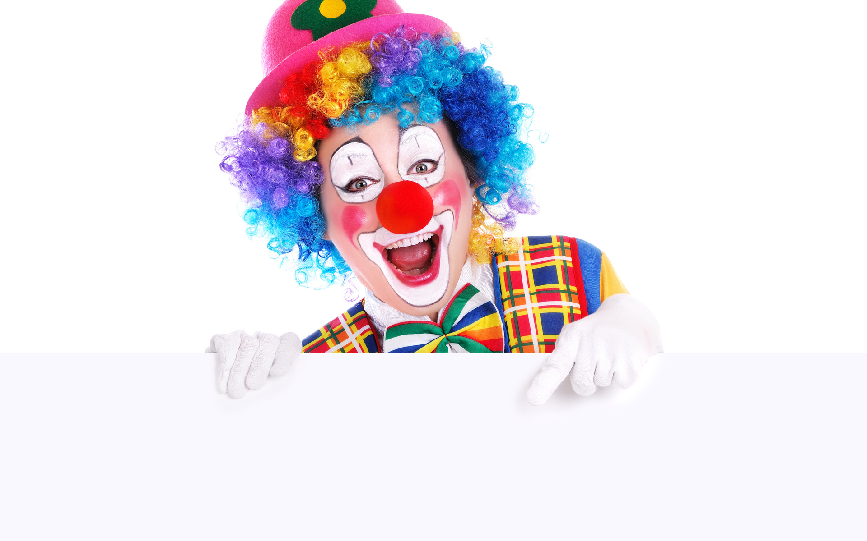
1
2
3
4
A clown makes
people laugh
5
6
7
8
`
What does a clown do?
answer

Slide 2

What does a teacher do?
A teacher teaches the students at school.
answer

Slide 3

What does a greengrocer do?
A greengrocer sells fruit and vegetables.
answer

Slide 4

What does a postman do?
A postman takes letters to people’s house.
answer

Slide 5

What does a waiter do?
A waiter serves people.
answer

Slide 6
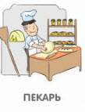
What does a barker do?
A barker bakes bread.
answer

Slide 7

What does a mechanic do?
A mechanic fixes cars.
answer

Slide 8

What does a nurse do?
A nurse helps sick people.
answer

