Slide 1


Negative prefix in English

Slide 2


Slide 3
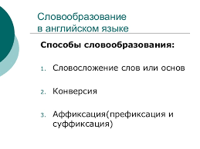

Slide 4
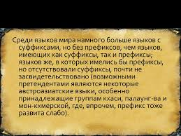

Slide 5
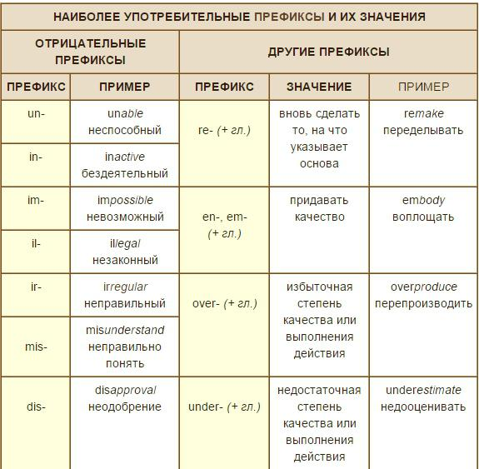
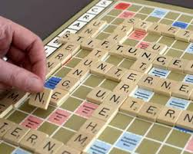

Slide 6
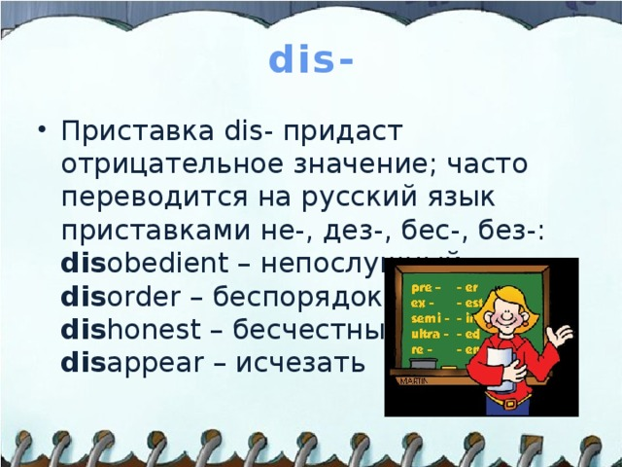

Slide 7
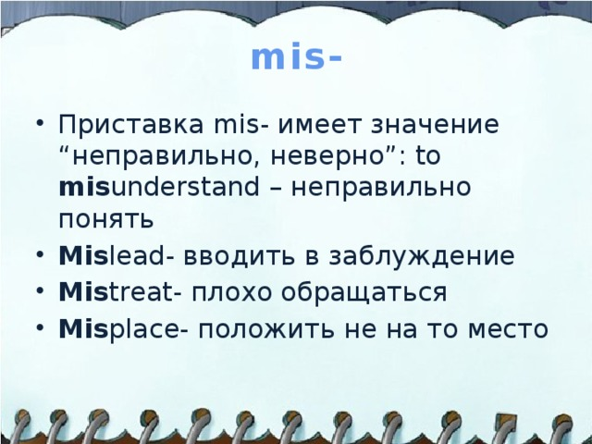

Slide 8






Date, __.
Classwork.
Перед названием профессии ставится артикль a!
-er
-or
+ =
job = occupation = work
Who are you?
I’m … (name).
work
teach
learn
act
write
sing
⇨worker
⇨teacher
learner
actor
⇨ writer
⇨ singer
What are you?
I’m a pupil/ a teacher/a doctor.
What do you want to be?
Кем ты хочешь быть?

Slide 9


Slide 10
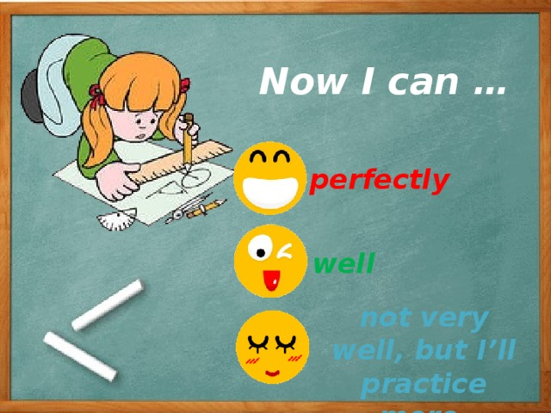

Slide 11


Slide 12


Slide 13


