Slide 1


All
tenses
in English
Идея
Ирины Ботнарь

Slide 2
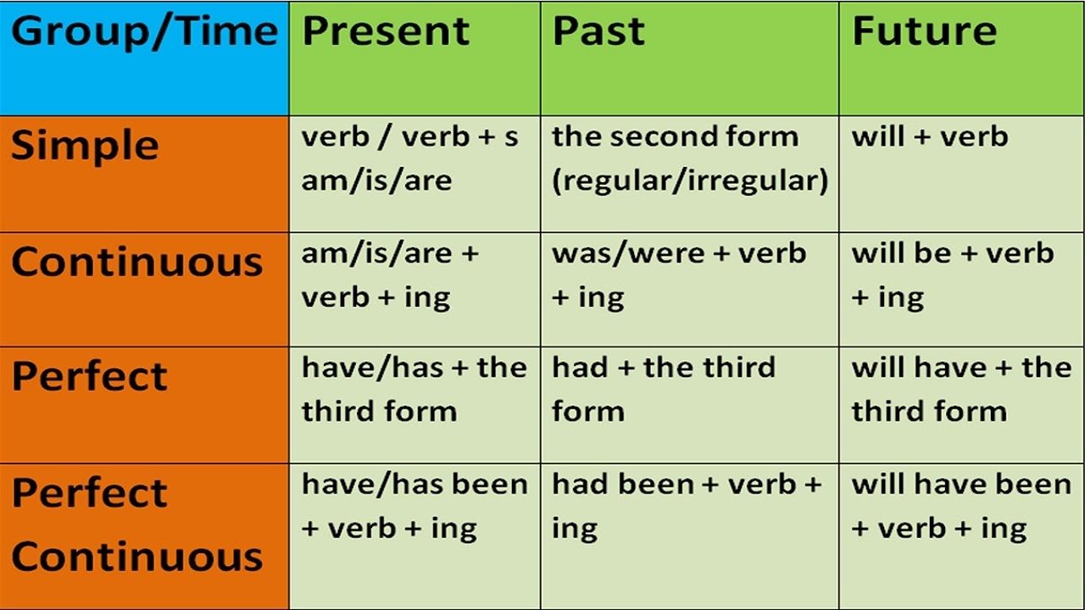
СLICK
Past
Present
Future
at 5 o’clock,
when he came
now, right now,
today
tomorrow at this
time
always
usually
often
never
ever
every…
3 times a…
Perfect
Continuous
Perfect
Continuous
Perfect
Continuous
result+
duration
How ?
Tom played football every day.
Tom plays football every day.
Tom will play football every day.
Tom was playing football.
Tom is playing football.
Tom will be playing
football every day.
since the time when
since then, for an hour, for a long time, already
since for, by this time
result
Perfect
Perfect
Perfect
Yesterday when I came to the gym Tom looked tired.
He had been playing
for 2 hours by then.
Look at Tom. He is so tired
Нe has already been
playing
for hours .
Tomorrow I’ll come to the gym at 11.
By this time Tom
will have been
playing
for two hours .
By 5 o’clock,
last Monday
today, this week,
already, recently
tomorrow at this time,
by this time next Monday
Continuous
Continuous
Continuous
duration
Tom was 15.
By the age of 15 he had played 7 tournaments.
Tom will be 25.
By the age of 25 he
will have played 27 tournaments.
Simple
Tom is 21.
Нe has played 15 tournaments.
regularity
Simple
Simple
СLICK
When ?

